Slide 1
Large Language Models
By Torey Akers

Slide 2

Training process of generative AI LLMs
Large language models learns from patterns and probabilities. In the process the text in a dataset is broken into tokens. The model is given a sequence of words and the model attempts to predict the next word. The end goal of the training process is for the model to be able to produce writings, conversations, and reasoning on a human like level.

Slide 3

Collecting and processing Data
This process consist of gathering and massive diverse text datasets
These datasets must be cleaned, tokenized and normalized . This ensure that the data is high quality which his needed to improve accuracy and reduce hallucinations.
This Photo by Unknown Author is licensed under CC BY

Slide 4
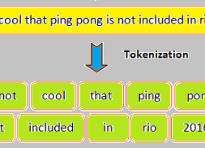
Tokenization
Breaks each word in the text, the raw text, into single tokens. These token transform the text in dataset to numbers so that the model can process them.
This Photo by Unknown Author is licensed under CC BY-SA-NC

Slide 5
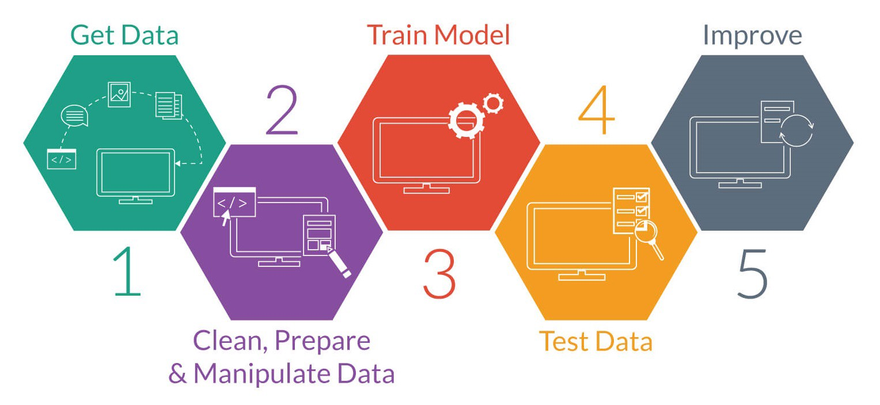
Pre Training
The model learns general patterns from the entire dataset. This is accomplished by showing the models a sequence of text with a word in the text hidden or removed. The model tries to predict the hidden or missing word.
Once the model makes a prediction, the loss functions measures how wrong the prediction is from the actual answer.
The process could last or weeks and up to months.
This Photo by Unknown Author is licensed under CC BY-SA-NC

Slide 6
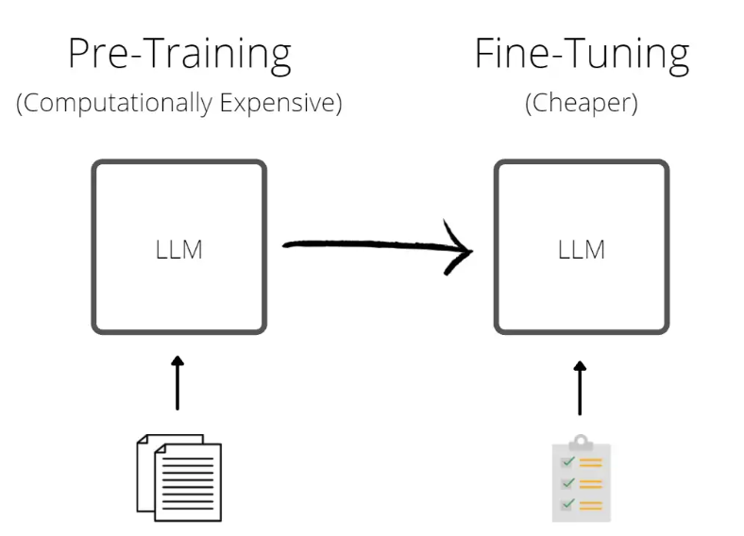
Fine Tuning
Now that the text in the dataset is clean and tokenized, the models needs to know how to be helpful, safe, and task specific.
Fine tuning is when the model is trained on smaller, labeled datasets to specialize in specific tasks or domains.
The goal of fine tuning is for the model to be able to in specialize in specific task or domains.
This Photo by Unknown Author is licensed under CC BY-NC-ND

Slide 7
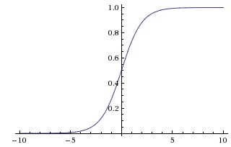
Reinforcement learning from Human Feedback
Aligning the model's behavior with human values and preferences. The model's outputs are ranked in order for a reward model to be trained.
This Photo by Unknown Author is licensed under CC BY-NC

Slide 8

Evaluation
The model is tested on new or unseen data to evaluate the models accuracy and coherence.
This Photo by Unknown Author is licensed under CC BY-SA

Slide 9
Summary
This visual element, created in PowerPoint, illustrates the key steps in the training process for Generative Artificial Intelligence Large Language Models (LLMs). The process includes the following stages:
Data Collection
Data Cleaning and Processing
Pre‑Training the Model
Fine‑Tuning
Reinforcement Learning from Human Feedback (RLHF)
Model Evaluation
Deployment

